Slide 1
Charter Oak District Klondike Derby 2023
Saturday, February 11 Sunday, February 12
Camp Workcoeman

Slide 2
Charter Oak District Klondike Derby 2023 Prep Meeting Agenda
Klondike Derby Overview
Check In Process
Rules & Instructions
Skill Questions
Course Plotting
Safety
Clothing & Equipment
Meal Planning
Q&A

Slide 3
Charter Oak District Klondike Derby 2023 Overview
The Charter Oak District Klondike Derby is a traditional type derby.
It is an intensive orienteering and camping competition, part
backpacking, part survival, and part winter camping.
The patrols are given distances and bearings and are required to
plot a course in specific order to 5 towns (stations).
Patrols will earn nuggets (points) based on total elapsed time
required to reach the towns, and the total number of nuggets
awarded to the patrol by the mayor of each town for skills
demonstrated.

Slide 4
Charter Oak District Klondike Derby 2023 Overview
Day Course
One-day event for patrols without winter tent camping experience,
and those patrols with fewer map and compass skills.
3:30 PM Finish time (Saturday)
4:30 PM Scores announced / parent pick up
Overnight Course
Two-day event for patrols experienced in orienteering skills and
familiar with winter tent camping.
11:30 AM Finish time (Sunday)
12:30 PM Scores announced / parent pick up

Slide 5
Charter Oak District Klondike Derby 2023 Overview
Registration
Registration is required for both scouts and adults.
Cost is $10 per scout and no charge for adults
Register on the Council website by February 3, 2023
Email the Klondike Derby roster form by February 3, 2023
Registered scouts and adults will get a Klondike patch.
No walk-ups will be allowed

Slide 6
Charter Oak District Klondike Derby 2023 Check In Process
Check In – times will be assigned prior to the event
Safety Check – entire patrol
Clothing – appropriate winter clothing to include insulated boots, warm hat, gloves, long underwear, snow resistant pants, jacket. No shorts and no sneakers.
Equipment – tents, sleeping bag, cooking equipment, water,
Registration – Patrol leader
Roster review
Pick up patrol packet including course card
Mapping – entire Patrol
Receive map and plot your course. Note everyone should bring a compass.
Start – entire Patrol
Must report to starting line staff and get start time recorded.

Slide 7
Charter Oak District Klondike Derby 2023 Rules
Patrols must have a minimum of 4 and maximum of 8 scouts.
Saturday lunch, Saturday Dinner and Sunday breakfast are judged.
Patrols must have their start time recorded.
Patrols must have their finish time recorded. Even if they do not reach all the stations they must have this time recorded.
Patrols must check in and out with the Mayor at each station.
Patrols must turn in their nuggets and course card to the Klondike HQ.
Patrols must keep their earned nuggets safe and their patrol card dry.

Slide 8
Charter Oak District Klondike Derby 2023 Rules
The use of GPS devices, including smart phone apps, is not allowed and is grounds for disqualifications.
The overnight course requires a sledge for each Patrol (assuming adequate snow cover).
The day course does not require a sledge, but it is encouraged.
Patrols requiring help with scout safety will not be penalized.
Under no circumstances is a Patrol to proceed across frozen lake, swamp or large body of water.

Slide 9
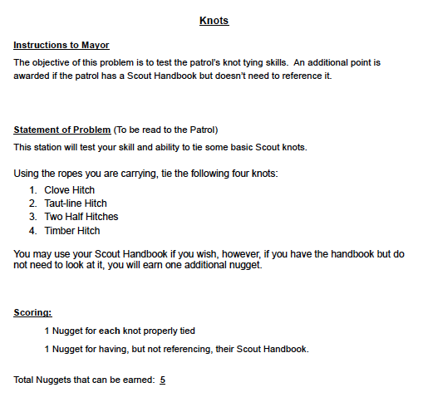
Charter Oak District Klondike Derby 2023 Skill Questions
All questions will come from the Scout Handbook.

Slide 10
Charter Oak District Klondike Derby 2023
Course Plotting

Slide 11
Charter Oak District Klondike Derby 2023 Course Plotting
Equipment
Compass
Pencil
Ruler
Map case / ziplock bag to protect map
Clip board
Process
Map the entire course before you start!
Closed loop course – start and end at the same point
Dead reckoning vs. orienteering method

Slide 12
Charter Oak District Klondike Derby 2023 Course Plotting

Slide 13
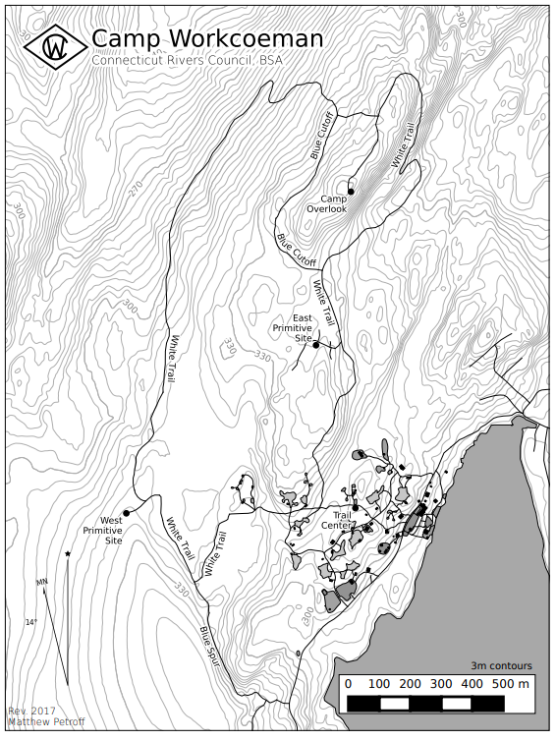
Charter Oak District Klondike Derby 2023 Course Plotting

Slide 14
Charter Oak District Klondike Derby 2023
Safety

Slide 15
Charter Oak District Klondike Derby 2023 Safety
Important Safety Notes
All participants must be properly equipped
Foot ware
Clothing
Camping equipment
Under no circumstances should a Patrol continue if any member is in jeopardy of a cold weather injury – seek immediate aid from the nearest station
Patrol Leaders must have 100% accountability of their Patrols at all times

Slide 16
Charter Oak District Klondike Derby 2023 Safety
What is Hypothermia?
Causes of Hypthermia
A condition that occurs when the body starts losing heat more quickly than it can produce it, resulting in the body’s temperature going down rapidly
Exposure to cold
Dehydration
Wind
Damp Clothing
Hunger
Exhaustion

Slide 17
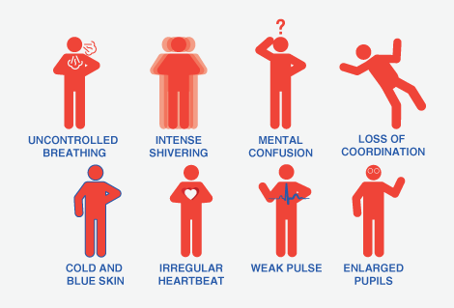
Charter Oak District Klondike Derby 2023 Safety
Hypothermia Symptoms

Slide 18
Charter Oak District Klondike Derby 2023 Safety
Hypothermia Prevention
Dress in layers…wicking clothing is the key
Ensure you have a wind layer… protect yourself from wind chill
Wear a hat…your head acts as a chimney
Regulate your temperature…when active and at rest
Stay hydrated…just as important in cold weather as hot weather
Stay energized…snacking, substantial meals are a must
Do not overexert yourself…monitor your Patrol
Avoid getting wet if at all possible…avoid water obstacles
If you do get wet…change clothing immediately
Change into dry clothes before bed…plan and pack accordingly

Slide 19
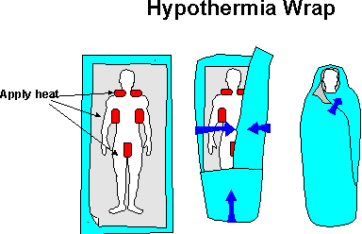
Charter Oak District Klondike Derby 2023 Safety
First Aid for Hypothermia
Prevent victim from getting colder
Move person into shelter and into dry, warm clothes
Zip person into dry sleeping bag; cover head with dry hat or hood
Provide warm water bottles to hold in armpit and groin areas
If conscious offer small amounts of warm liquids (cocoa, kool aid, water)
SEEK HELP RIGHT AWAY

Slide 20
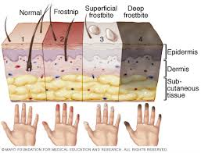
Charter Oak District Klondike Derby 2023 Safety
What is Frostbite
Causes of Frostbite
Frostbite is a condition that occurs when the skin is exposed to temperatures cold enough that ice crystals form in the tissue.
Exposure to cold
Dehydration
Wind
Toes, fingers, nose, and ears are especially vulnerable.

Slide 21
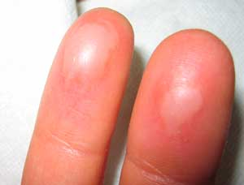
Charter Oak District Klondike Derby 2023 Safety
Frostbite Symptoms
Pain on the skin of the nose, ears, fingers or feet.
Prickling feeling or numbness
Red, white, bluish-white or
Grayish – yellow skin
Skin that feels unusually firm or waxy.
Blistering after rewarming, in severe
cases.

Slide 22
Charter Oak District Klondike Derby 2023 Safety
Preventing Frostbite
Protect vulnerable areas from cold and wind
Wear mittens / gloves
Wear a hat that covers your ears
Make sure your boots are not too tight…extra socks can sometimes cause more harm than good!
Continuously wiggle your fingers and toes…keep the blood flowing

Slide 23
Charter Oak District Klondike Derby 2023 Safety
First Aid for Frostbite
Get the victim into a tent or shelter
Gently warm the injury
Nose / ears: Using the palm of your or the victim’s hand
Fingers / hands: Placing the hand inside the victims clothing, under the armpit or between your hands
Feet / toes: Place victim’s bare feet against your bare stomach
Immerse in warm (not hot) water
Have the victim exercise the area (fingers and toes)
DO NOT RUB THE INJURY
SEEK HELP RIGHT AWAY

Slide 24
Charter Oak District Klondike Derby 2023
Clothing & Equipment

Slide 25
Charter Oak District Klondike Derby 2023 Clothing
Remember the 3-W’s
Wicking Base Layer
Warmth Mid Layer
Wet / Wind Outer Layer
Remember to regulate
your heat while on
the course.

Slide 26
Charter Oak District Klondike Derby 2023 Clothing
Waterproof insulated boots – no sneakers
Warm hat that covers ears
Wool / wicking socks
Long underwear
Warm snow-resistant pants
Warm jacket
Warm mittens or gloves – protect extremities
Clean & dry clothes for sleeping, including a hat
Two pairs of extra socks
Extra clothes – be prepared!

Slide 27
Charter Oak District Klondike Derby 2023 Equipment
Course
Camping equipment
Note day course is required to have one each
Tents
Ground cloth (under tent)
Ground pad (under sleeping bag)
Winter sleeping bag or bag and liner combination
Cooking equipment
Stove
Sledges – required for overnight
Map case / ziplock bag to protect map
Clipboard

Slide 28
Charter Oak District Klondike Derby 2023 CEquipment
Compass
Pencil
Ruler
Ropes (1) 1’ and (6) 6’ lashing ropes
Emergency blanket
First aid kit
Emergency supply of gator aide, cocoa or bullion.
Ten essentials
Note: this is not an all inclusive list, and it is each Patrols responsibility to determine what they need to bring.

Slide 29
Charter Oak District Klondike Derby 2023 Meal Planning
Meals
Day – Saturday hot lunch and drink
Overnight – Saturday hot lunch and drink
Saturday hot dinner and drink
Sunday hot breakfast and drink
Sunday lunch (optional)
Water
Bring your own water for drinking and cooking.
Water will be available at the rear of the dining hall and Griffin Lodge.

Slide 30
Charter Oak District Klondike Derby 2023 Meal Planning
Drinking fluids is just as important in winter as it is in hot weather. Drink plenty of fluids.
Your body is a furnace, and food is the fuel that feeds it. Hot foods – think soups, stews, chili.
Plan your meals for ease of preparation and clean up.
MRE’s are acceptable but you will earn extra points if you prepare your own. It is acceptable to make something at home that you will reheat.
Remember leave no trace – carry out what you carry in.

Slide 31
Charter Oak District Klondike Derby 2023
Questions ?

